Slide 1
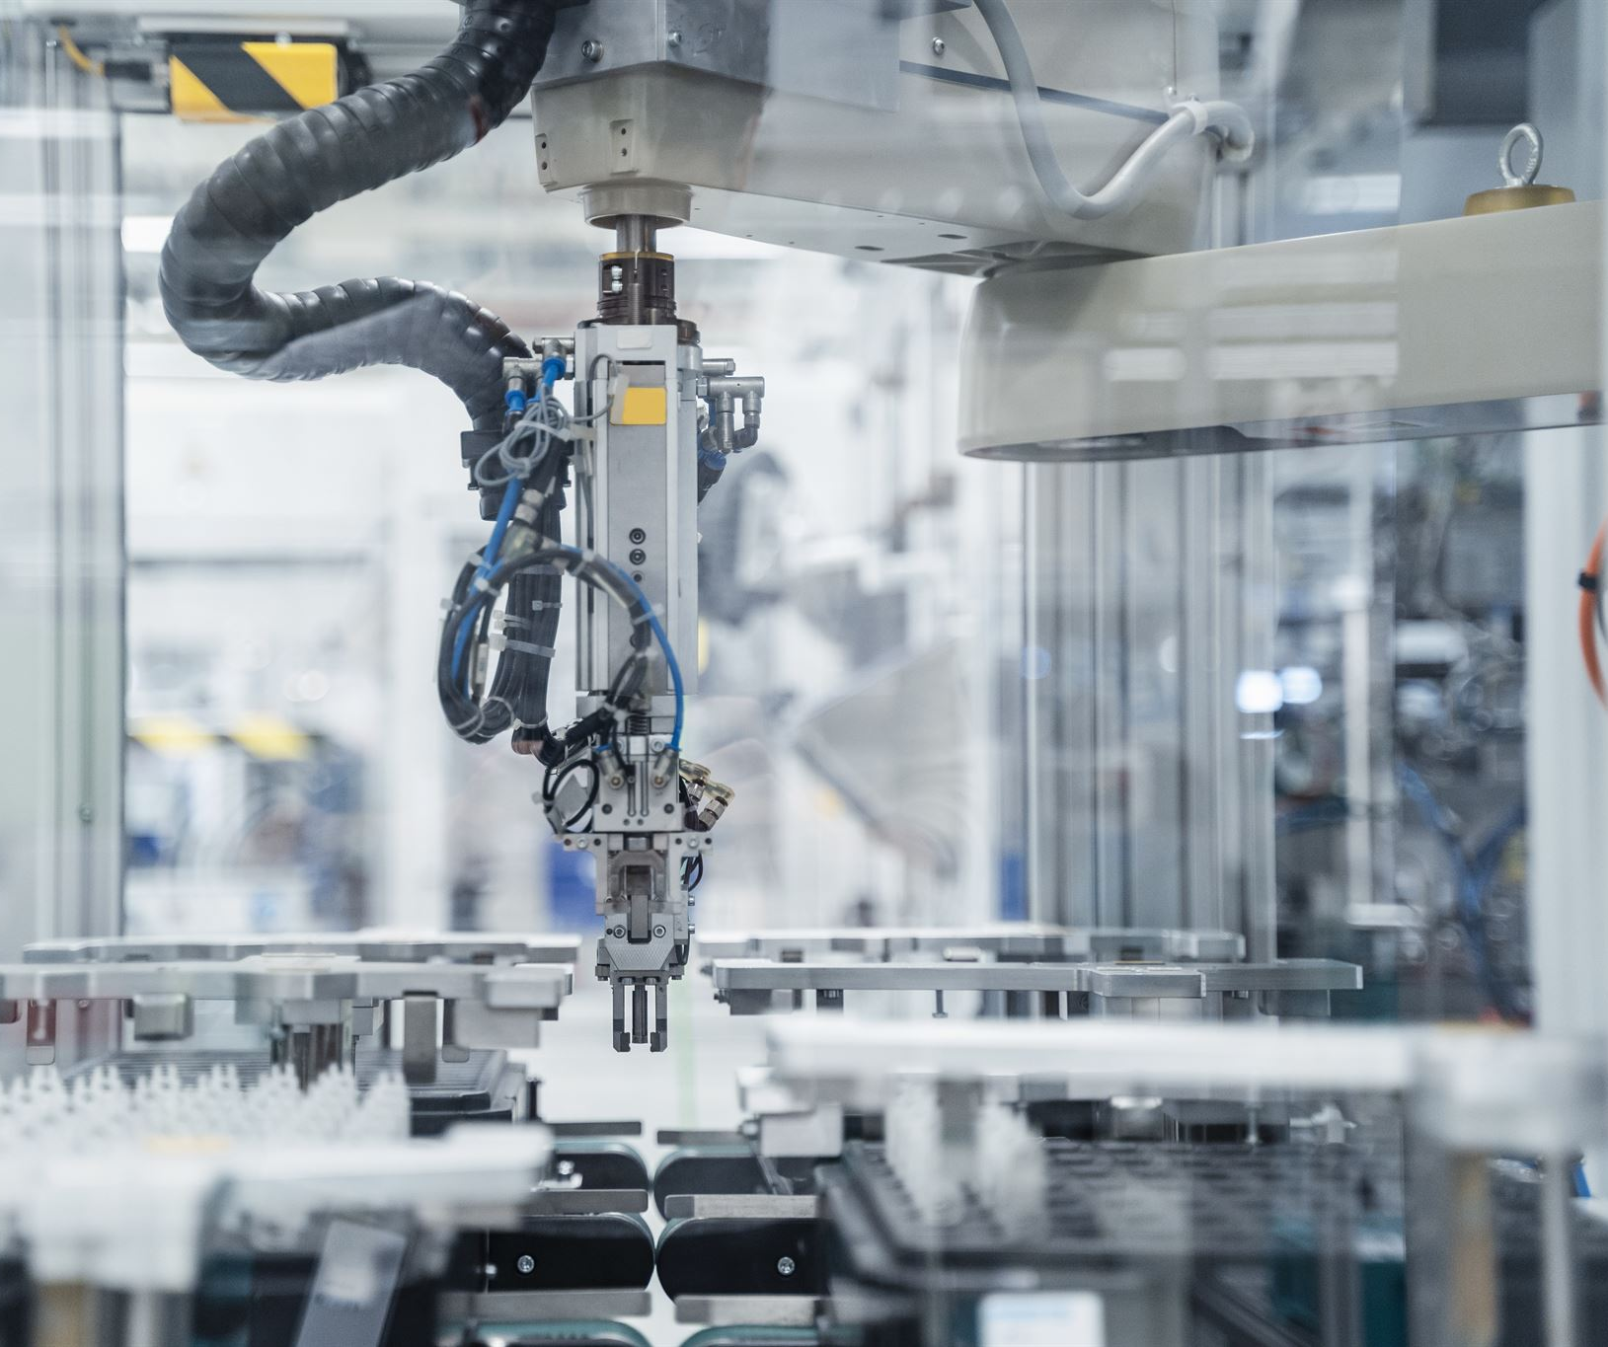
AI in Manufacturing
AI's impact on efficiency and innovation in production
Alfredo Garza, Richard Rodriguez, Olaleye Bakare, Khizar Khan
July 9, 2025
Notes:
AI-generated content may be incorrect. --- Artificial Intelligence (AI) is revolutionizing the manufacturing industry by enhancing efficiency, improving quality, and driving innovation. In this presentation, we will explore the role of AI in manufacturing, its technologies, benefits, challenges, real-world applications, and future trends. Image source: Microsoft 365 content library

Slide 2
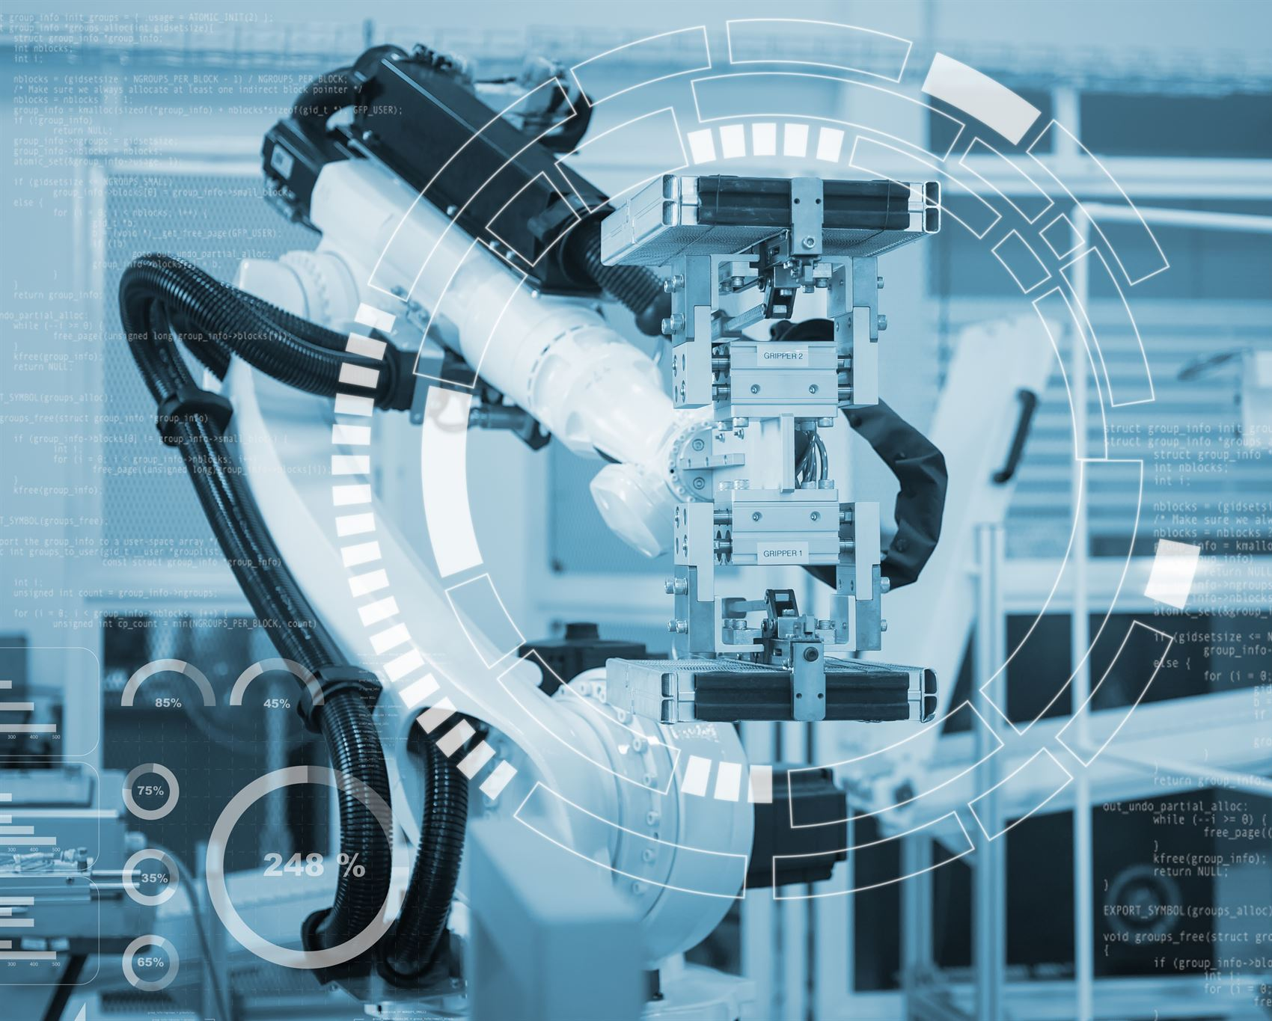
Agenda Items
Introduction to AI in Manufacturing
Key AI Technologies in Manufacturing
Benefits of AI in Manufacturing
Challenges and Limitations
Case Studies and Real-World Examples
Future Trends and Developments
Notes:
--- We'll begin with an introduction to AI in manufacturing, defining key concepts and providing an overview of applications. Then, we'll delve into key AI technologies, discuss the benefits of AI, and outline the challenges faced in the sector. We'll also explore case studies and conclude with future trends in AI technologies within manufacturing. Image source: Microsoft 365 content library

Slide 3
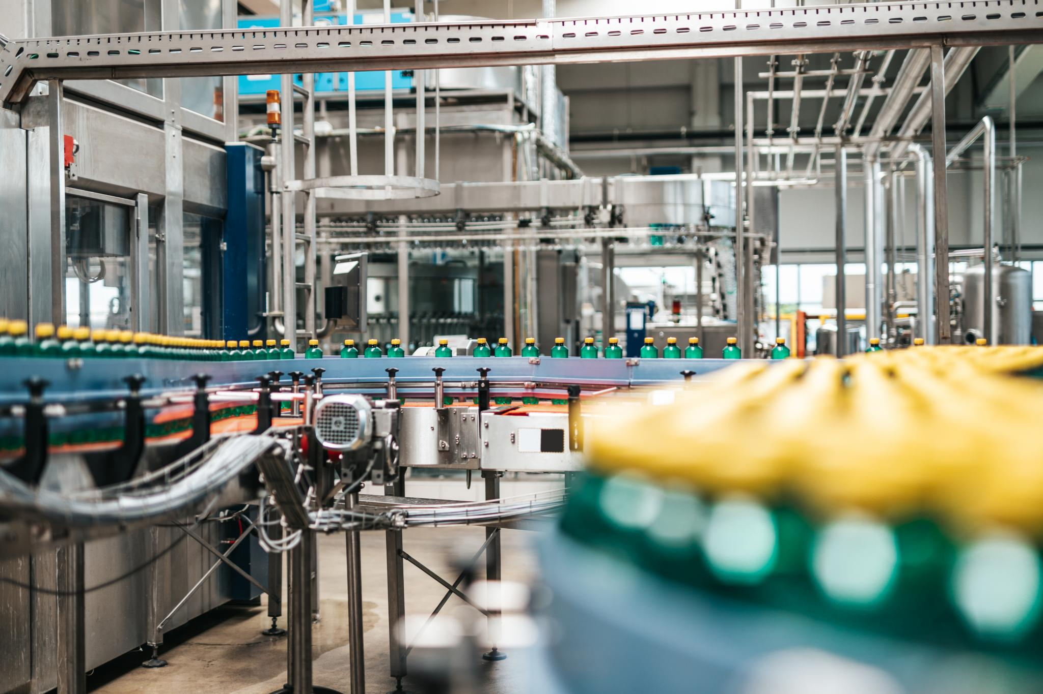
Manufacturing: Domain & Impact
Transforming Raw Materials
Manufacturing converts raw materials into finished products through the use of machines, labor, and advanced technology.
Economic Growth Driver
This sector forms the backbone of global economies by driving economic growth, innovation, and technological advancement.
Industry Challenges
Manufacturing faces challenges such as supply chain disruptions, labor shortages, quality issues, and rising operational costs.
Notes:
Manufacturing is the process of converting raw materials into finished goods using machinery, labor, and technology. It serves as the backbone of global economies, driving growth and innovation. Despite its significance, the sector faces challenges such as supply chain disruptions, labor shortages, quality control issues, and rising costs.

Slide 4
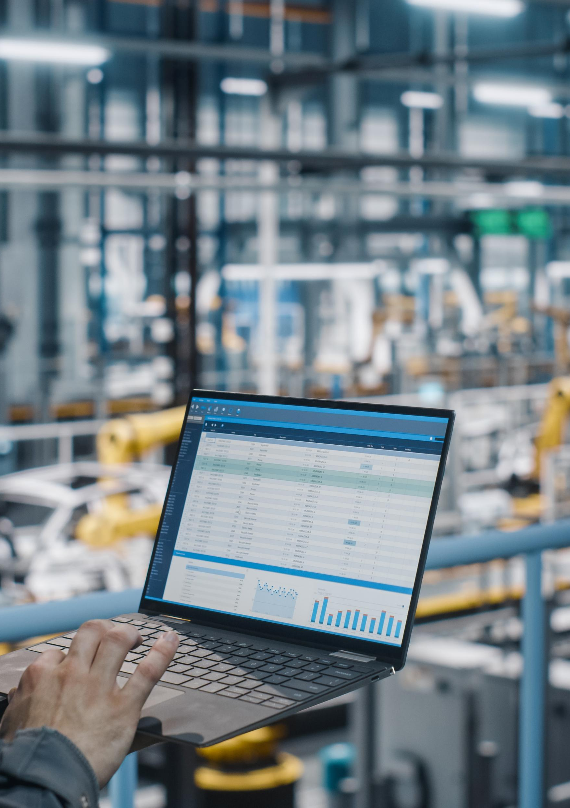
AI Motivation in Industry
Solving Industrial Challenges
AI helps tackle inefficiencies, reduce unplanned downtime, and improve product consistency in industrial environments.
Predictive Maintenance
AI-powered predictive maintenance anticipates equipment failures, preventing costly disruptions and extending machinery lifespan.
Quality Control with Computer Vision
Computer vision detects defects on assembly lines in real time, ensuring high product quality and reducing waste.
Notes:
AI addresses key industrial challenges like production inefficiencies, unplanned downtime, and inconsistent quality. Predictive maintenance uses AI to anticipate and prevent equipment failures, minimizing costly disruptions. Additionally, computer vision enables real-time defect detection on assembly lines, ensuring product quality and reducing waste.

Slide 5
Overview of AI Applications in Manufacturing
Predictive Maintenance
Predictive maintenance uses AI to assess equipment health, predicting failures before they occur to minimize downtime.
Supply Chain Optimization
AI enhances supply chain optimization by analyzing data to improve inventory management and delivery efficiency.
Demand Forecasting
AI enables accurate demand forecasting, allowing manufacturers to align production with market demand effectively.
Notes:
--- AI applications in manufacturing include predictive maintenance, supply chain optimization, and demand forecasting, helping organizations streamline operations and improve productivity. These technologies enable factories to operate more efficiently and responsively. Image source: Microsoft 365 content library

Slide 6
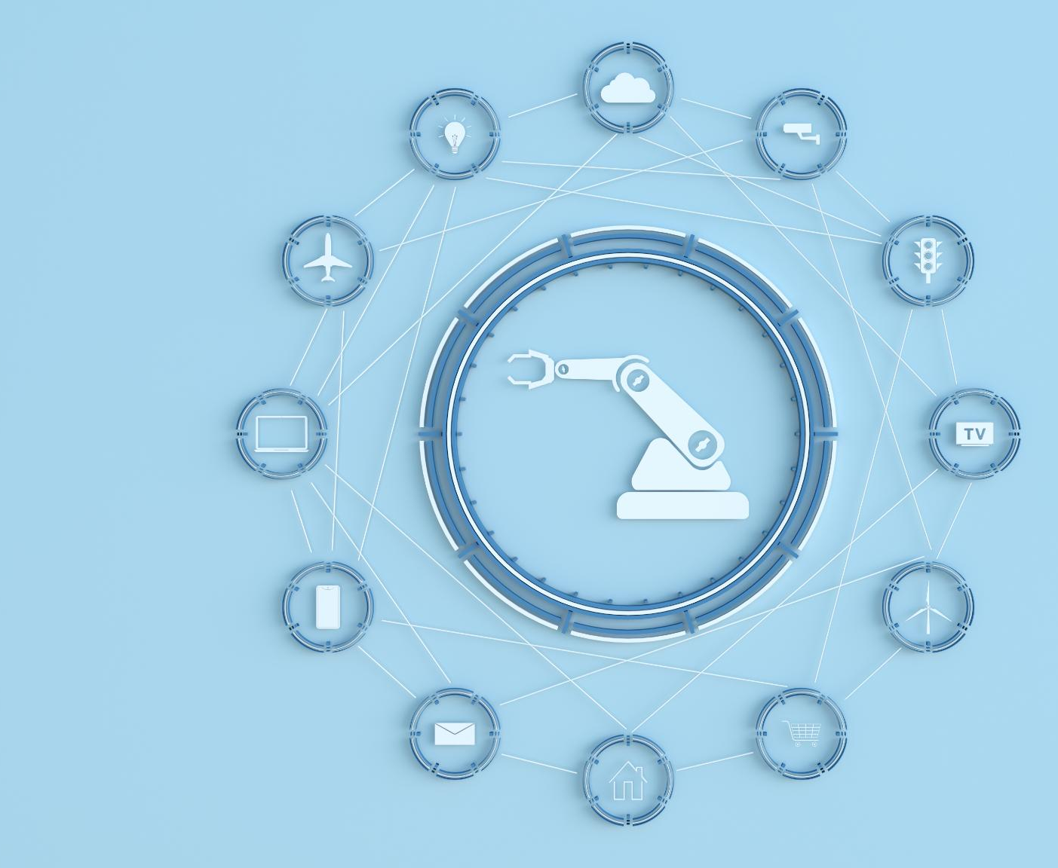
Machine Learning and Predictive Analytics
Data Analysis with Machine Learning
Machine learning algorithms play a crucial role in analyzing historical data to uncover patterns, which helps in making informed predictions.
Predicting Future Outcomes
By identifying patterns, machine learning enables the prediction of future outcomes, which is essential for effective decision-making.
Optimizing Maintenance in Manufacturing
Predictive analytics in manufacturing helps foresee equipment failures, allowing for optimized maintenance schedules and minimizing downtime.
Notes:
--- Machine learning algorithms analyze historical data to identify patterns and predict future outcomes. In manufacturing, predictive analytics can foresee equipment failures, optimizing maintenance schedules and reducing downtime. Image source: Microsoft 365 content library

Slide 7
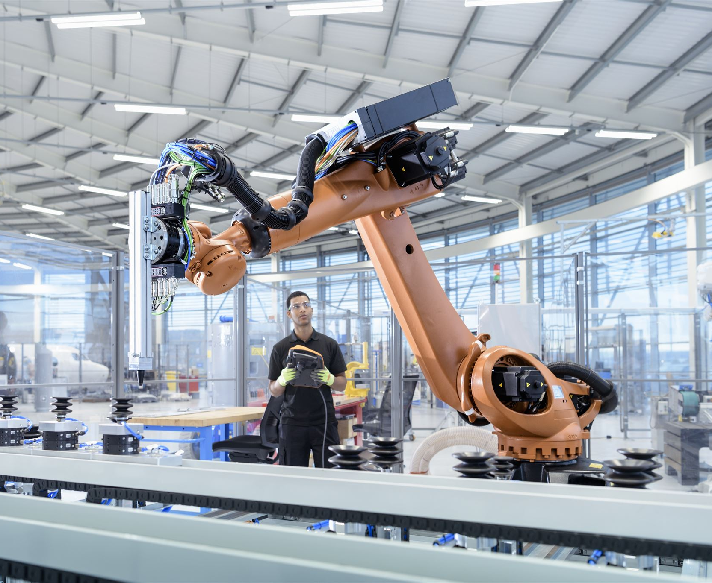
Robotics and Automation
Automation of Tasks
Robotics automates repetitive tasks, significantly improving efficiency and safety in various industries.
Collaborative Robots (Cobots)
Cobots are designed to work alongside human workers, enhancing productivity and safety in manufacturing environments.
Notes:
--- Robotics plays a crucial role in automating repetitive tasks, improving efficiency and safety. Cobots, or collaborative robots, work alongside human workers, enhancing productivity in various manufacturing environments. Image source: Microsoft 365 content library

Slide 8

Computer Vision and Quality Control
Visual Data Interpretation
Computer vision enables machines to accurately interpret and analyze visual data, transforming how industries monitor quality.
Defect Detection
These technologies can detect defects and anomalies in products, ensuring that only high-quality items reach customers.
Waste Reduction
By enhancing product quality through effective monitoring, computer vision systems help reduce waste in production processes.
Notes:
--- Computer vision technologies enable machines to interpret and analyze visual data, ensuring quality control in production. By detecting defects and anomalies, these systems enhance product quality and reduce waste. Image source: Microsoft 365 content library

Slide 9
Increased Efficiency and Productivity
AI-Driven Automation
AI-driven automation helps streamline processes, reducing manual labor and increasing efficiency in production.
Optimizing Production Processes
Optimizing production processes through analytics leads to improved throughput and reduced cycle times in manufacturing.
Higher Throughput
By implementing AI and automation, manufacturers can achieve higher throughput, reflecting improvements in productivity.
Notes:
--- AI-driven automation and analytics significantly boost operational efficiency. By optimizing production processes and reducing cycle times, manufacturers can achieve higher throughput and productivity. Image source: Microsoft 365 content library

Slide 10

Cost Reduction and Resource Optimization
Identifying Inefficiencies
AI technologies assist manufacturers in pinpointing inefficiencies in production processes, enabling targeted improvements.
Optimizing Resource Allocation
Resource optimization through AI leads to better allocation of materials, labor, and energy in manufacturing.
Cost Savings
Implementing AI solutions results in significant cost savings in materials, labor, and energy consumption.
Improved Profitability
Overall profitability is enhanced as manufacturers reduce costs and increase operational efficiency through AI technologies.
Notes:
--- AI technologies help manufacturers identify inefficiencies and optimize resource allocation. This leads to substantial cost savings in materials, labor, and energy consumption, improving overall profitability. Image source: Microsoft 365 content library

Slide 11

Enhanced Product Quality and Consistency
Real-Time Monitoring
AI employs real-time monitoring to ensure high product quality by continuously assessing production standards.
Advanced Data Analytics
Data analytics allows for early detection of defects, minimizing errors and enhancing overall product quality.
Improved Customer Satisfaction
Consistent product quality results in fewer customer complaints and significantly boosts customer satisfaction.
Notes:
--- Through real-time monitoring and analysis, AI ensures consistently high product quality. Advanced data analytics enable early detection of defects, leading to fewer errors and improved customer satisfaction. Image source: Microsoft 365 content library

Slide 12

Implementation and Integration Difficulties
Complex Integration Process
Integrating AI technologies into manufacturing processes often involves multiple intricate steps, making the transition challenging.
Interoperability Challenges
Ensuring that new AI systems can work seamlessly with existing legacy systems presents significant interoperability challenges.
Maintaining Operational Continuity
Smooth transitions during integration are crucial to avoid disruptions in manufacturing operations and ensure productivity.
Notes:
--- Integrating AI technologies into existing manufacturing processes can be complex. Challenges include interoperability with legacy systems and ensuring smooth transitions without disrupting operations. Image source: Microsoft 365 content library

Slide 13

Data Privacy and Security Issues
Rising Concerns
With the growth of data-driven AI systems, manufacturers face increased concerns regarding data privacy and security.
Protecting Sensitive Information
It is essential to protect sensitive information to maintain trust and avoid legal repercussions in data management.
Regulatory Compliance
Ensuring compliance with data protection regulations is crucial for manufacturers to avoid penalties and protect user data.
Notes:
--- As manufacturers increasingly rely on data-driven AI systems, concerns about data privacy and security arise. Protecting sensitive information and ensuring compliance with regulations is crucial. Image source: Microsoft 365 content library

Slide 14

Skill Gap and Workforce Adaptation
AI Technologies Advancement
The rapid advancement of AI technologies is leading to a significant skill gap in the workforce.
Training and Upskilling
Manufacturers must invest in training programs to upskill employees and help them adapt to new technologies.
Smooth Transition
Investing in workforce development ensures a smooth transition to AI technologies in manufacturing processes.
Notes:
--- The rapid advancement of AI technologies creates a skill gap in the workforce. Manufacturers must invest in training and upskilling employees to adapt to new technologies and ensure a smooth transition. Image source: Microsoft 365 content library

Slide 15

Success Stories From Leading Manufacturers
AI in Manufacturing
Leading manufacturers have adopted AI technologies to optimize their production processes, significantly enhancing operational efficiency.
Cost Reduction Strategies
By integrating AI, companies have successfully reduced production costs while maintaining high-quality standards in their manufacturing processes.
Case Studies as Models
These success stories provide valuable insights for other organizations looking to implement AI in their manufacturing operations.
Notes:
--- Companies like Siemens and General Electric have successfully integrated AI into their manufacturing processes, resulting in improved efficiency and reduced production costs. These case studies serve as valuable models for other organizations. Image source: Microsoft 365 content library

Slide 16

Lessons Learned and Best Practices
Importance of Data Quality
High-quality data is critical for the success of AI implementations as it directly influences the accuracy of outputs.
Need for Clear Strategy
A clear strategy for AI implementation ensures alignment with business goals and maximizes the impact of AI technologies.
Fostering Innovation Culture
Cultivating a culture of innovation within organizations encourages experimentation and adoption of AI technologies effectively.
Notes:
--- Key takeaways from successful AI implementations include the importance of data quality, the need for a clear strategy, and fostering a culture of innovation within organizations to fully leverage AI technologies. Image source: Microsoft 365 content library

Slide 17

Emerging AI Technologies and Their Potential
Edge Computing
Edge computing brings data processing closer to the source, improving response times and bandwidth efficiency.
AI-Driven IoT
AI-driven IoT enhances device connectivity and data analysis, enabling smarter decision-making across various industries.
Advanced Robotics
Advanced robotics automates tasks with precision and flexibility, significantly improving manufacturing processes and productivity.
Notes:
--- Technologies such as edge computing, AI-driven IoT, and advanced robotics are on the horizon. These innovations promise to further enhance manufacturing efficiency, flexibility, and competitiveness. Image source: Microsoft 365 content library

Slide 18

Impact on Global Manufacturing Landscape
AI in Manufacturing
The adoption of AI technologies in manufacturing will streamline processes and boost efficiency across industries.
Global Competition
AI will foster increased competition among countries as they strive to innovate and improve production capabilities.
Collaboration in Trade
As AI technologies are adopted, collaboration between countries will become essential to leverage shared resources and knowledge.
Notes:
--- AI will significantly alter the global manufacturing landscape, fostering increased competition and collaboration. As countries adopt AI technologies, the dynamics of global trade and production will shift. Image source: Microsoft 365 content library

Slide 19
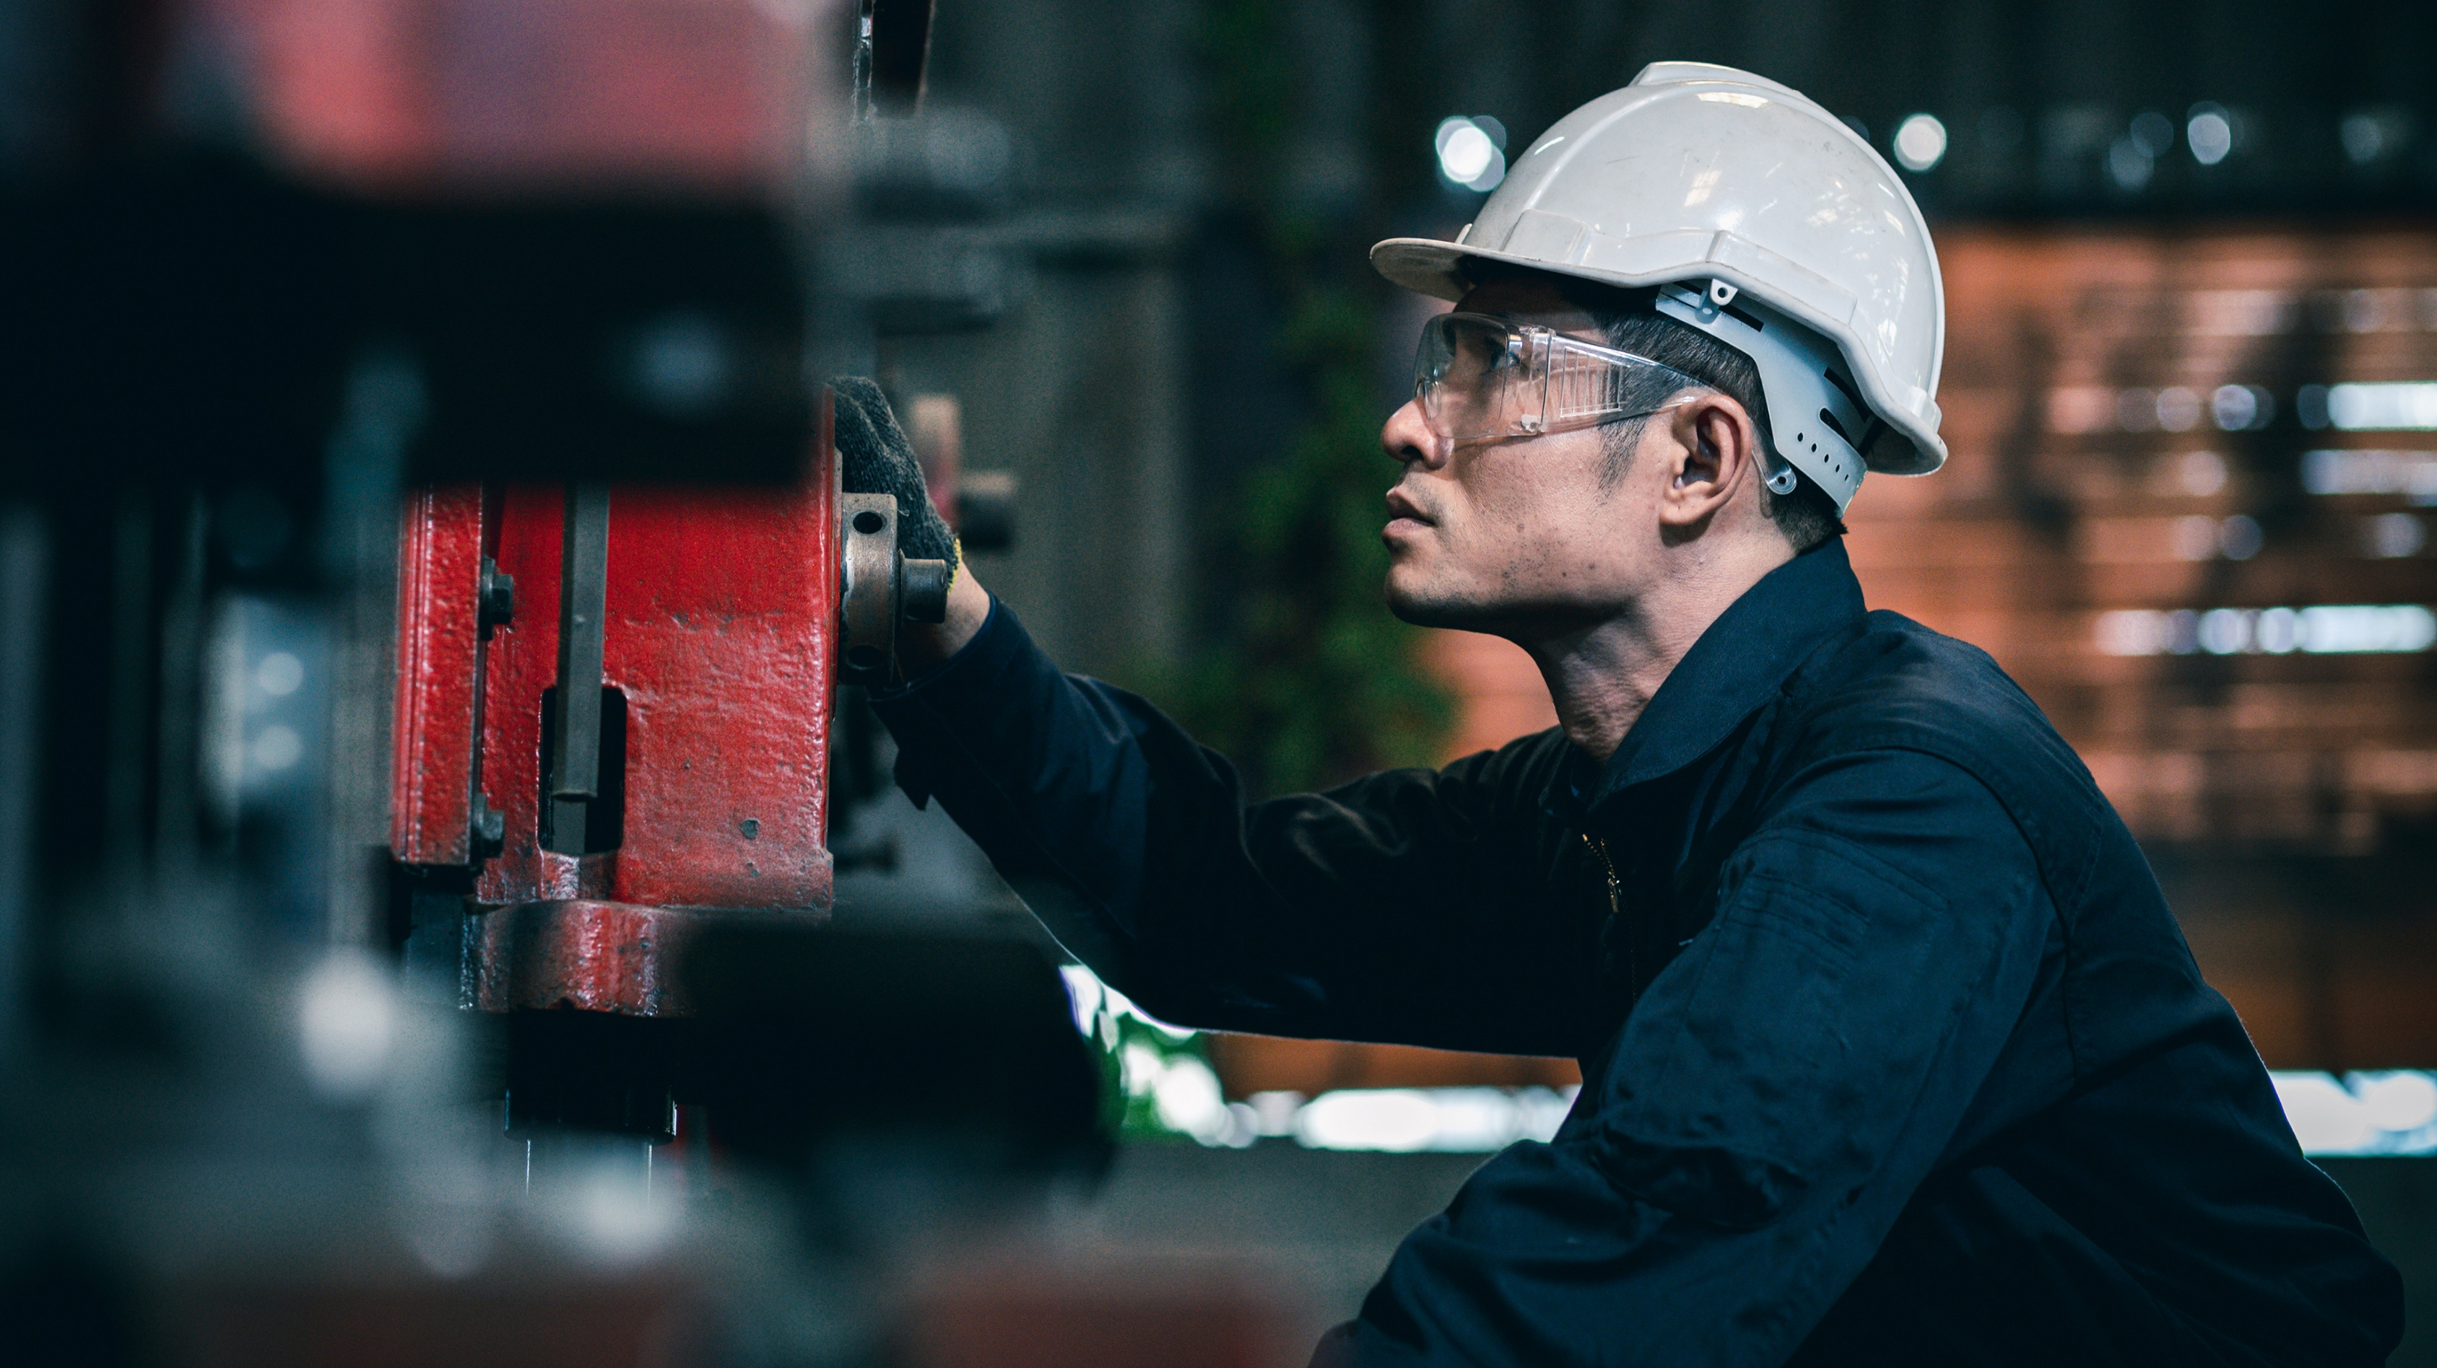
Demo
Gen AI Smart Manufacturing Demo of the Factory Whisperer | Cognizant
Notes:
AI is a transformative force in the manufacturing industry, offering numerous benefits while also presenting challenges. By understanding AI technologies and their implications, manufacturers can strategically position themselves for future success.

Slide 20

Predictions and Future Outlook
AI in Manufacturing
AI is expected to revolutionize manufacturing processes, enhancing productivity and operational efficiency across industries.
Productivity Improvements
The integration of AI technologies will lead to significant improvements in manufacturing productivity and innovation capabilities.
Competitive Market Advantage
Organizations that adopt AI-driven manufacturing will gain a competitive edge, enabling them to thrive in the market.
Notes:
--- Experts predict that AI will play a pivotal role in the future of manufacturing, driving unprecedented improvements in productivity and innovation. Organizations that embrace these changes will thrive in an increasingly competitive market. Image source: Microsoft 365 content library

Slide 21
Conclusion
AI's Transformative Impact
AI is revolutionizing the manufacturing industry by enhancing productivity and efficiency across various processes.
Benefits of AI
The integration of AI in manufacturing leads to improved quality control, predictive maintenance, and cost reductions.
Challenges Ahead
Despite its benefits, AI also presents challenges such as workforce displacement and the need for new skills.
Strategic Positioning
Understanding AI technologies allows manufacturers to adapt and ensure sustainable growth in a competitive market.
Notes:
AI is a transformative force in the manufacturing industry, offering numerous benefits while also presenting challenges. By understanding AI technologies and their implications, manufacturers can strategically position themselves for future success.

Slide 22

References
General Electric. (2022). Digital twins in manufacturing: Optimizing performance and reducing downtime. https://www.ge.com/digital/industries/manufacturing IBM (2023). AI-powered quality inspection in manufacturing. https://www.ibm.com/case-studies/ai-manufacturing-quality McKinsey & Company. (2021). The future of AI in manufacturing: A McKinsey perspective. https://www.mckinsey.com/business-functions/operations/our-insights/the-future-of-ai-in-manufacturing Microsoft Azure. (2023). *AI solutions for manufacturing. https://azure.microsoft.com/en-us/solutions/manufacturing/ NVIDIA. (2023). NVIDIA Metropolis: AI-powered video analytics for smart factories. https://www.nvidia.com/en-us/metropolis/ Siemens. (2022). Predictive maintenance with AI: A Siemens case study. https://new.siemens.com/global/en/products/services/predictive-maintenance.html U.S. Department of Energy. (2023). AI and machine learning in manufacturing: Opportunities and challenges. https://www.energy.gov/eere/amo/articles/ai-and-machine-learning-manufacturing World Economic Forum. (2022). Global Lighthouse Network: Unlocking sustainability through AI in manufacturing. https://www3.weforum.org/docs/WEF_Global_Lighthouse_Network_Unlocking_Sustainability_Through_4IR.pdf
Notes:
A blank references page provides space to list sources used in a presentation. It ensures proper credit is given to authors and supports academic integrity. Remember to format citations according to the required style (APA, MLA, etc.), and leave this slide ready for final source entries before submission.

